Slide 1

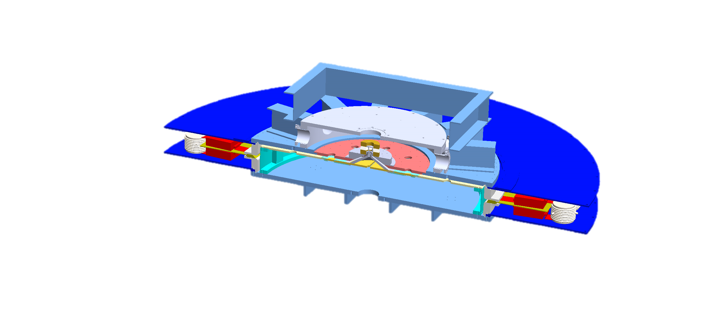
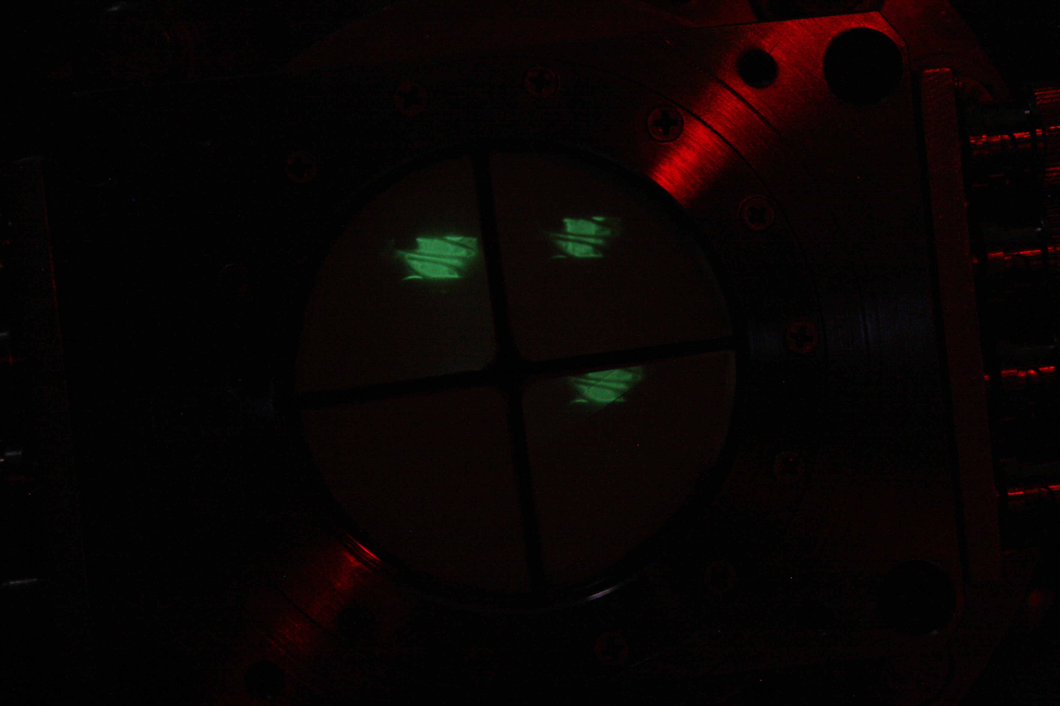
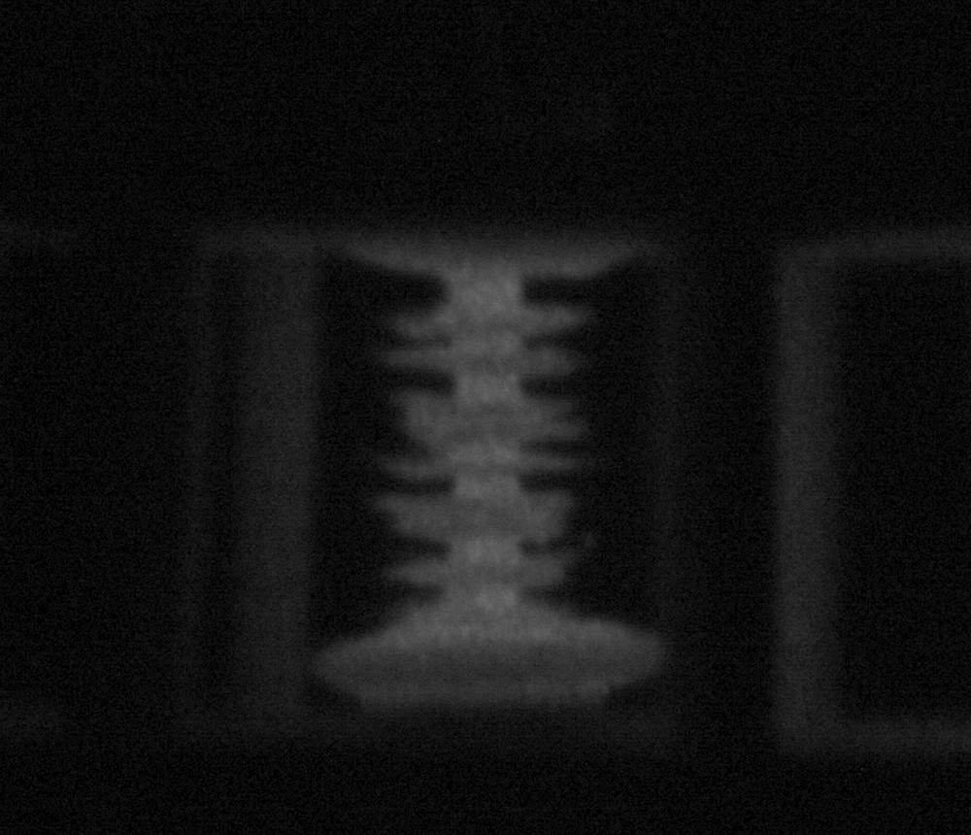
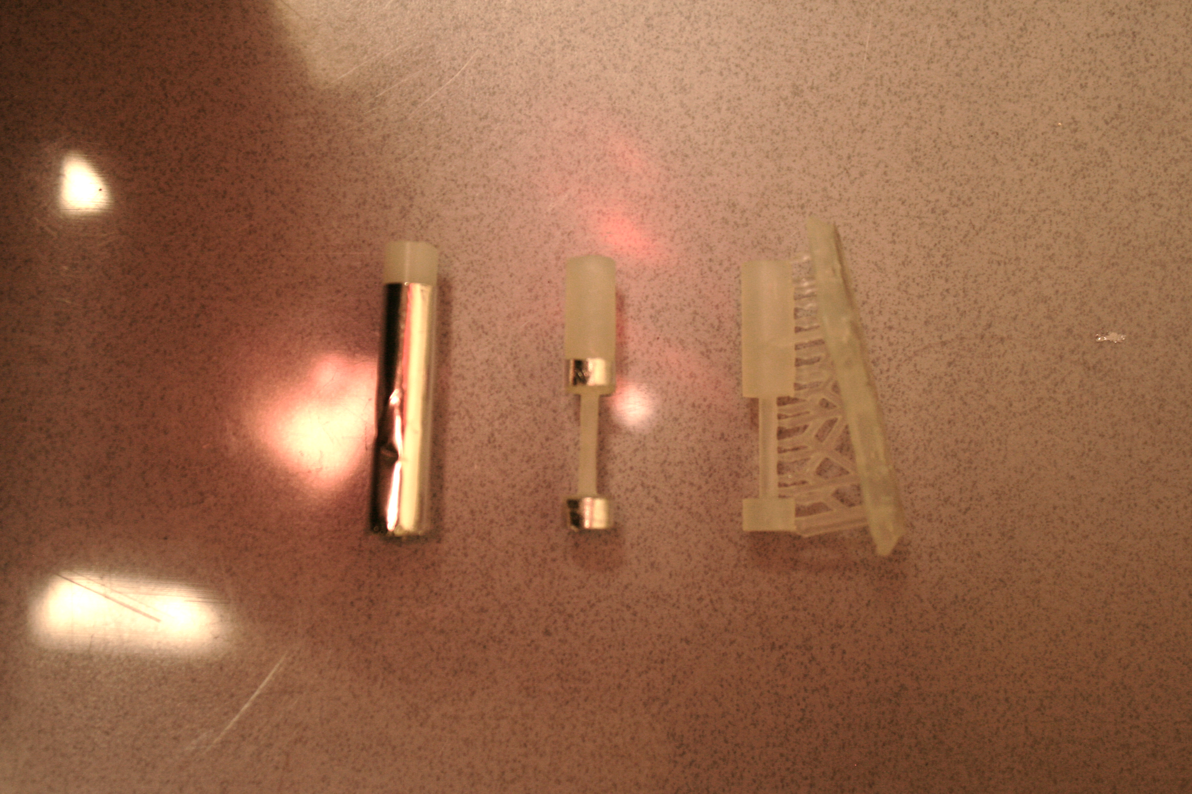
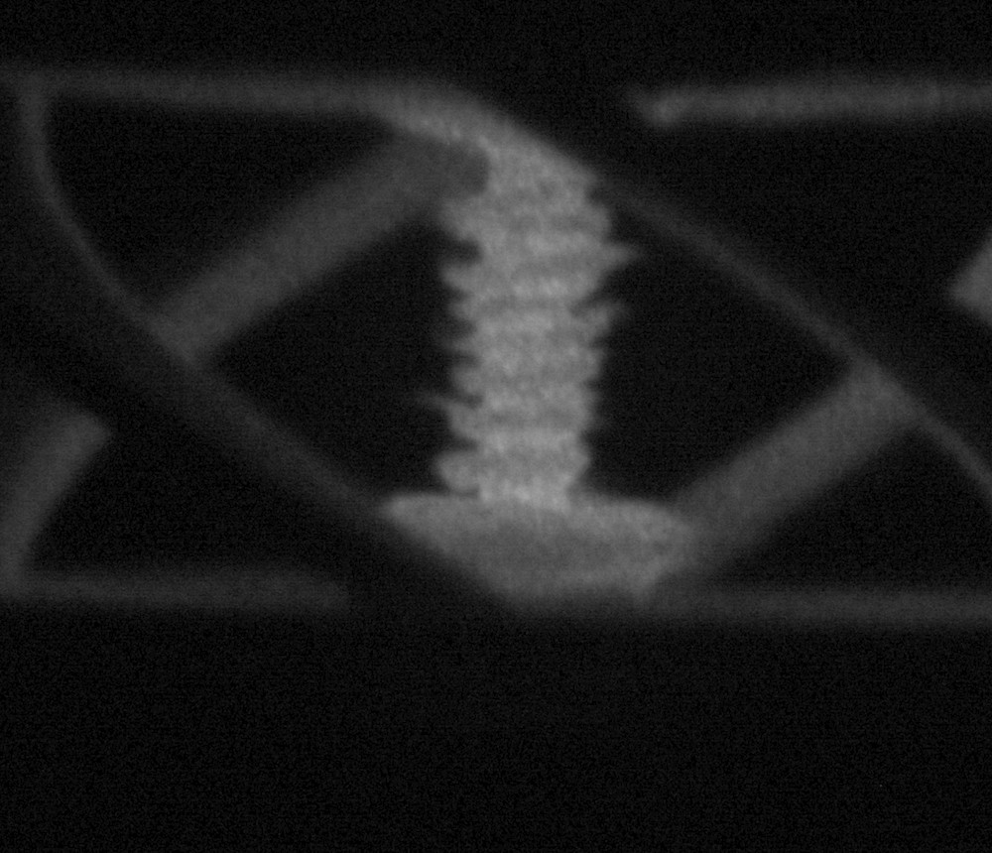
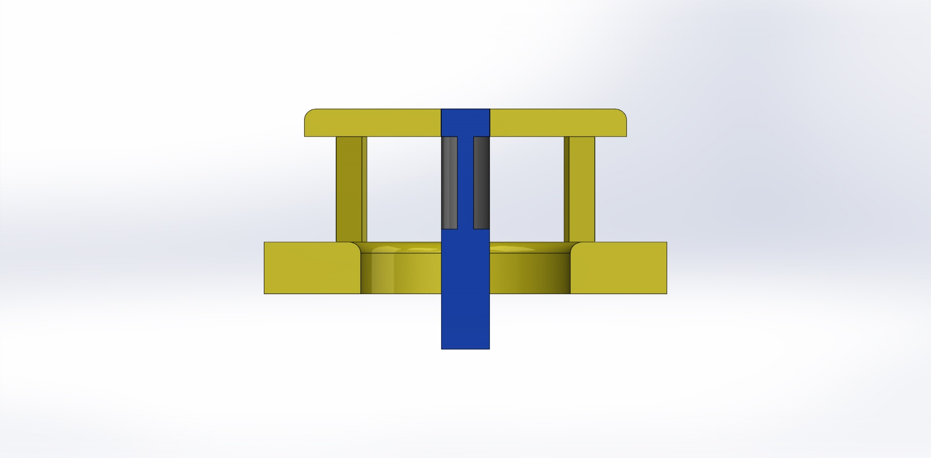
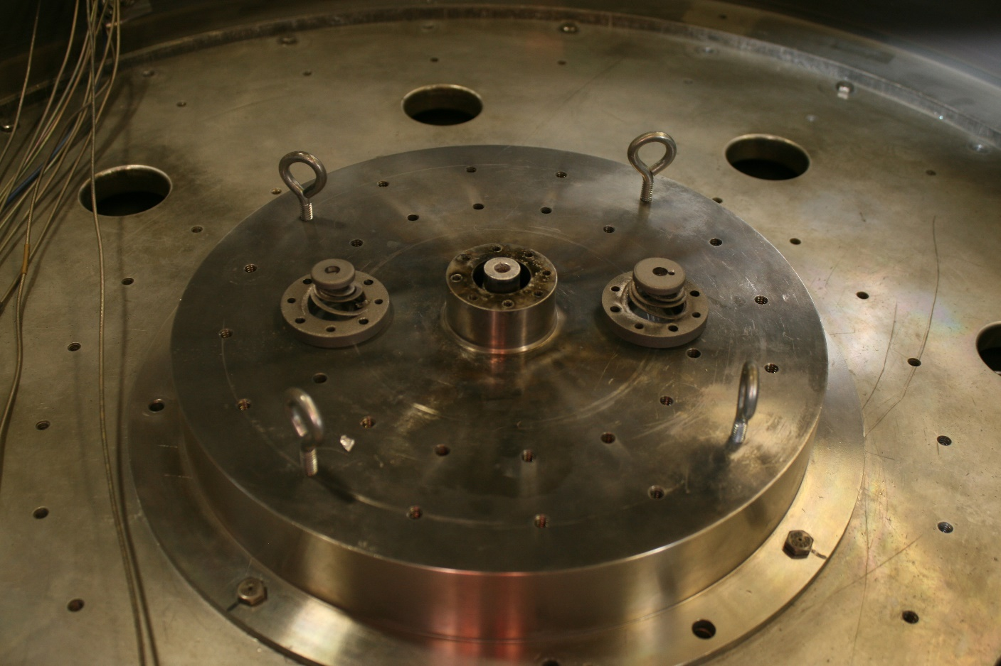
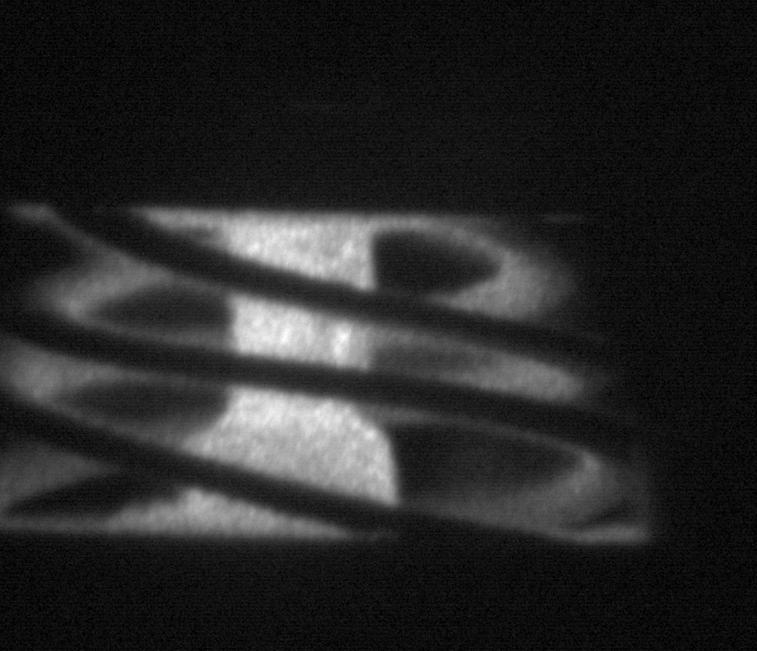
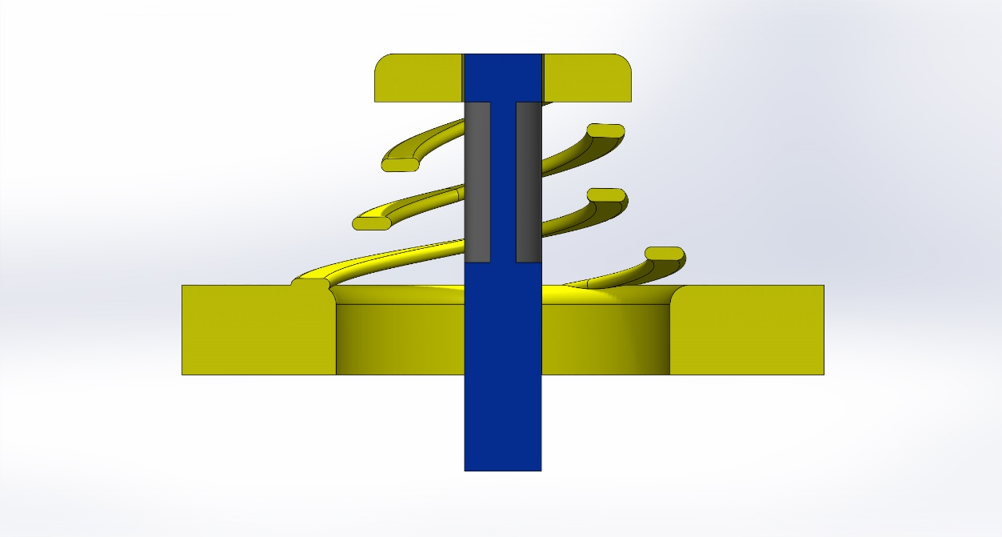
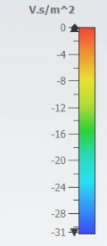
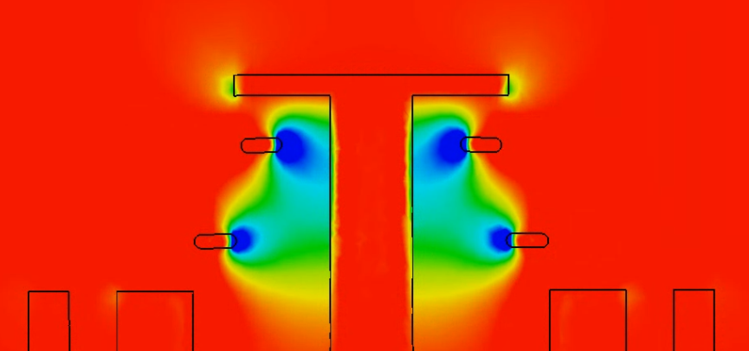


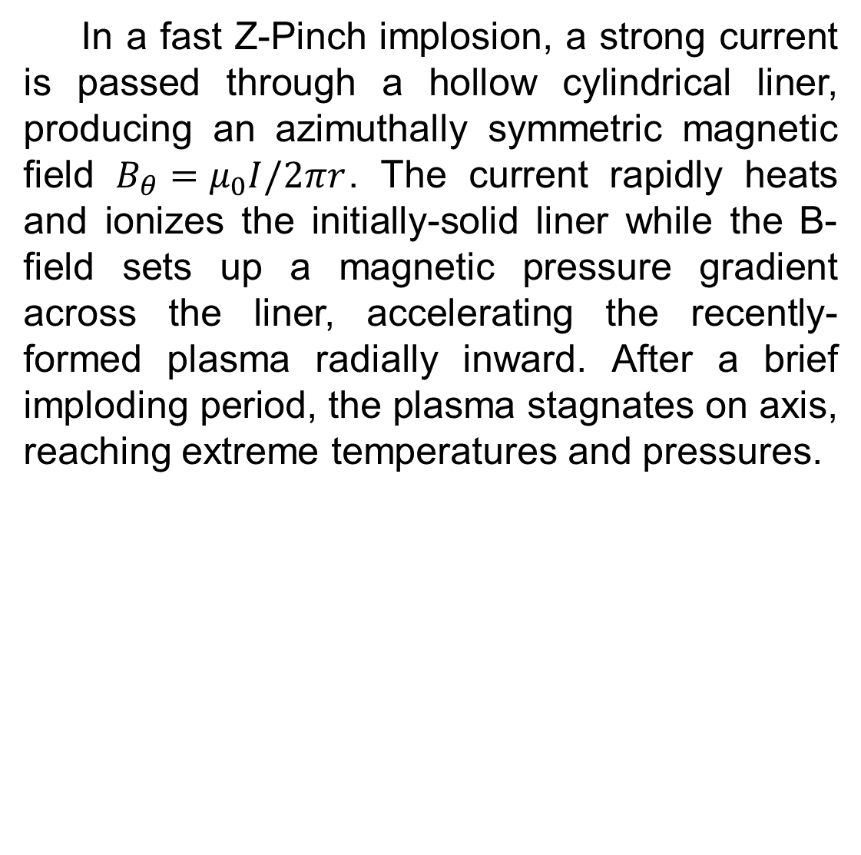

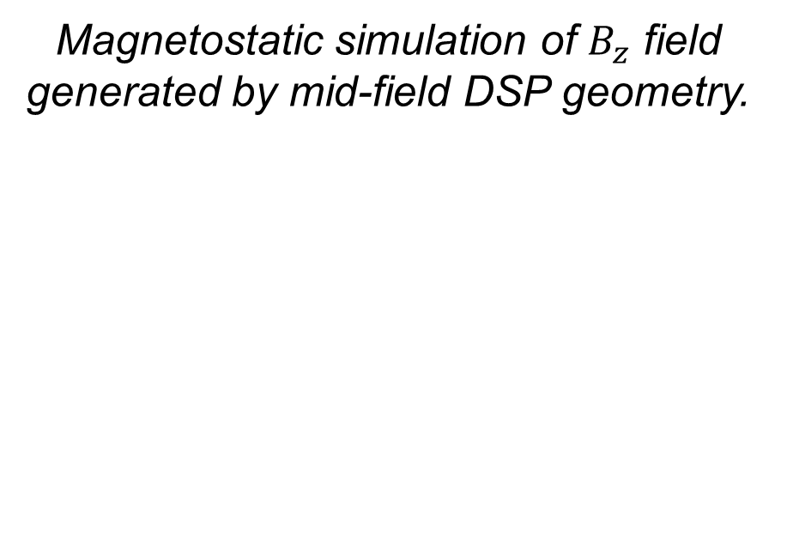
Stability Analysis of Dynamic Screw-Pinch Driven Thin-Foil Liner Implosions
A. Bedel, J. Chen, L. Tafoya, N. M. Jordan, and R. D. McBride
Nuclear Engineering and Radiological Sciences, University of Michigan
MAIZE Linear Transform Driver
Experimental Setup / Preliminary Analysis
The Michigan Accelerator for Inductive Z-Pinch Experiments (MAIZE) at the University of Michigan is an efficient, single-cavity Linear Transform Driver (LTD). MAIZE is capable of outputting a peak current of up to 1 MA with a rise time ≈ 150 ns. During each experiment, nearly 10 kJ of energy are stored across 40 pairs of capacitors (bricks) along the outer portion of the LTD’s 3m diameter. This geometry minimizes inductance, and allows fast delivery of energy to a central load.
Image at t=0
3D cross-section of MAIZE
Although MAIZE has the capability and history to conduct experiments across a wide range of experimental geometries, including a Dense Plasma Focus [1], Gas-Puff Z-Pinch [2], Exploding Wire-Array, and X-Pinch, its “standard” configuration and focus of this poster is of the Fast Z-Pinch.
35 mm
In a fast Z-Pinch implosion, a strong current is passed through a hollow cylindrical liner, producing an azimuthally symmetric magnetic field $B_{θ}=μ_{0}I/2πr$. The current rapidly heats and ionizes the initially-solid liner while the B-field sets up a magnetic pressure gradient across the liner, accelerating the recently-formed plasma radially inward. After a brief imploding period, the plasma stagnates on axis, reaching extreme temperatures and pressures.
24 shots, Flux compression,
geo specifications
Current
Path
Liner
Anode
Cathode
Standard Z-Pinch Geometry
Motivation for Dynamic Screw-Pinch
Z-Pinch plasmas have been used as strong x-ray sources, testbeds for plasma stability experiments, and are the basis of Magnetised Liner Inertial Fusion
Standard Z-Pinch (top), low-field DSP (middle) and mid-field DSP (bottom)
Diagnostics
Conclusions & Future Work
Anode
The Driving current on MAIZE is measured using a Rogowski coil surrounding the power feed. A 12-frame visible-spectrum fast framing camera (FFC) was used with a 4-frame XUV self-emission imaging system to diagnose MRTI growth. The XUV system consists of four, 200 µm pinholes coupled to four micro-channel scintillating plates, which are in turn imaged with a long exposure camera.
The low-field and mid-field DSP designs suppressed MRT instability growth significantly when compared to a SZP.
The failure of the high-field DSP to achieve significant compression is evidence of a significant diffusion of axial magnetic field through the outer liner early in time.
Cathode
Dynamic Screw-Pinch Geometry
3 DSP Designs
Bz/Bt
Magnetic Pitch Angle
Pitch equation
Flux Compression of $B_{z}$ by Z-Pinch plasma
Picture of FCC
Picture of Scintillator
Future experimental work will be aimed at using micro B-dot probes to measure the axial field on the interior and exterior of the DSP plasma in order to diagnose the rate and timing of hypothesized magnetic diffusion.
Simulation efforts, which have formerly been targeted towards thick-shelled MagLIF-like implosions, will be used to validate experimental findings
Magnetostatic simulation of $B_{z}$ field generated by mid-field DSP geometry.
[1] R. M. Gilgenbach, M. E. Read, K. E. Hackett, R. Lucey, B. Hui, V. L. Granatstein, K. R. Chu, A. C. England, C. M. Loring, O. C. Eldridge, H. C. Howe, A. G.Kulchar, E. Lazarus, M. Murakami, and J. B. Wilgen, “Heating at the Electron Cyclotron Frequency in the ISX-B Tokamak,” Phys. Rev. Lett., vol. 44, no 10, pp. 647-650, Mar. 1980.
[2] N. Friedman, "The Naval Institute Guide to World Naval Weapon Systems", 5th ed. Naval Institute Press, 2006.
[3] W. C. Brown, "Description and Operating Characteristics of the Plantinotron - A Microwave Tube Device." Proceedings of the IRE. Vol 45. Sept 1957.
[4] E. C. Okress. “Microwave Power Engineering: Generation, Transmission, Rectification”, Volume 1. Academic Press. 1968.
[5] S. C. Exelby Jr., “Recirculating Planar Crossed-Field Amplifiers”, University of Michigan, Ph.D. Dissertation, 2019.
[6] S. C. Exelby Jr. et al. “High-Power Amplification Experiments on a Recirculating Planar Crossed-Field Amplifier”, IEEE Transactions on Plasma Science, vol. 48, pp. 1917-1922, June 2020.

Slide 3
35 mm
Current Path
Liner
Anode
Cathode

